Slide 1
Year 4 | 8 Units | 9 Units
Year 3 | 7⁺ Units | 9⁺ Units
Year 2 | 3 Units | 3 Units
Year 1 | 3 Units | 3 Units
 | Semester 1 | Semester 2

Slide 2
Year 4 | 8 Units | 9 Units
Year 3 | 7⁺ Units | 9⁺ Units
Year 2 | 3 Units | 3 Units
Year 1 | 3 Units | 3 Units
 | Semester 1 | Semester 2

Slide 3
Year 4 | 8 Units | 9 Units
Year 3 | 7⁺ Units | 9⁺ Units
Year 2 | 3 Units | 3 Units
Year 1 | 3 Units | 3 Units
 | Semester 1 | Semester 2

Slide 4
Year 4 | 8 Units | 9 Units
Year 3 | 7⁺ Units | 9⁺ Units
Year 2 | 3 Units | 3 Units
Year 1 | 3 Units | 3 Units
 | Semester 1 | Semester 2

Slide 5
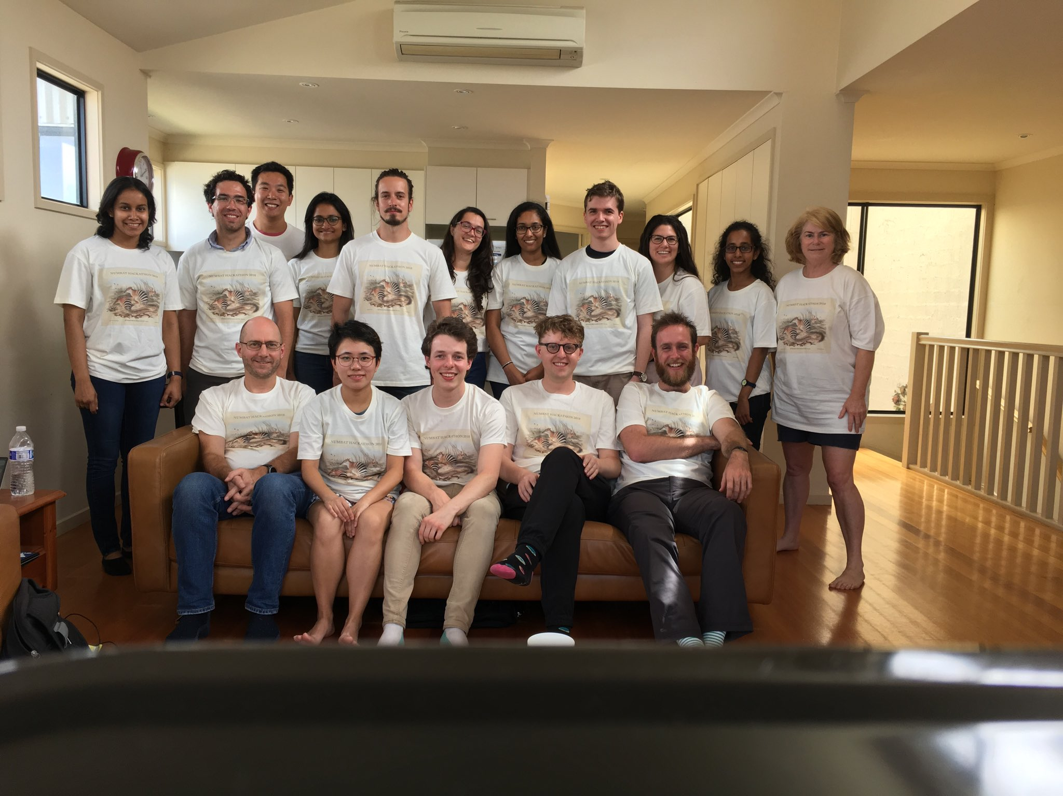
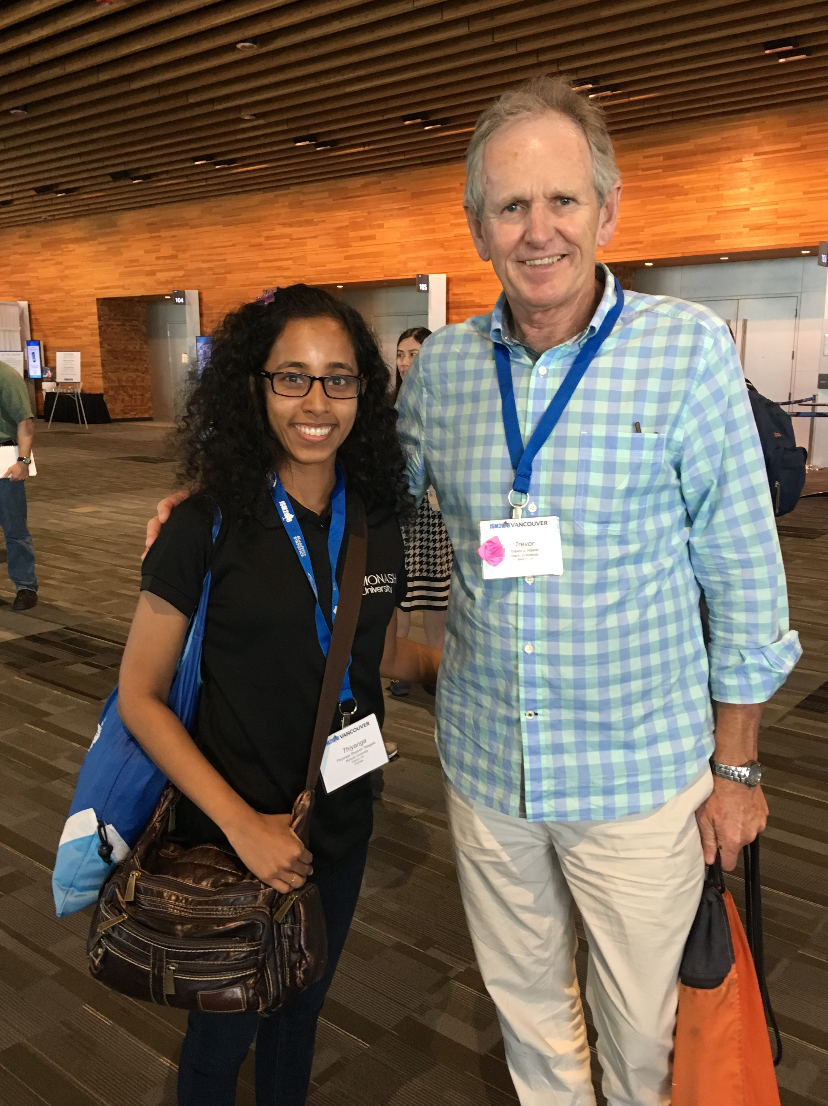

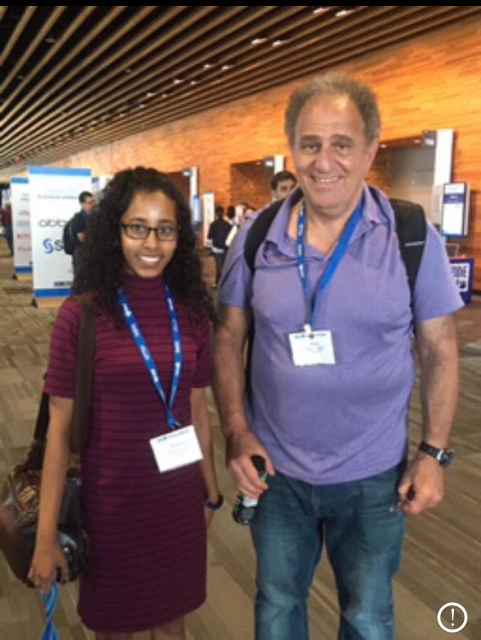
Prof Trevor Hastie
Prof Rob Hyndman, Prof Roger Peng, Prof Di Cook
Prof Robert Tibshirani
Dr Hadley Wickham

